Slide 1
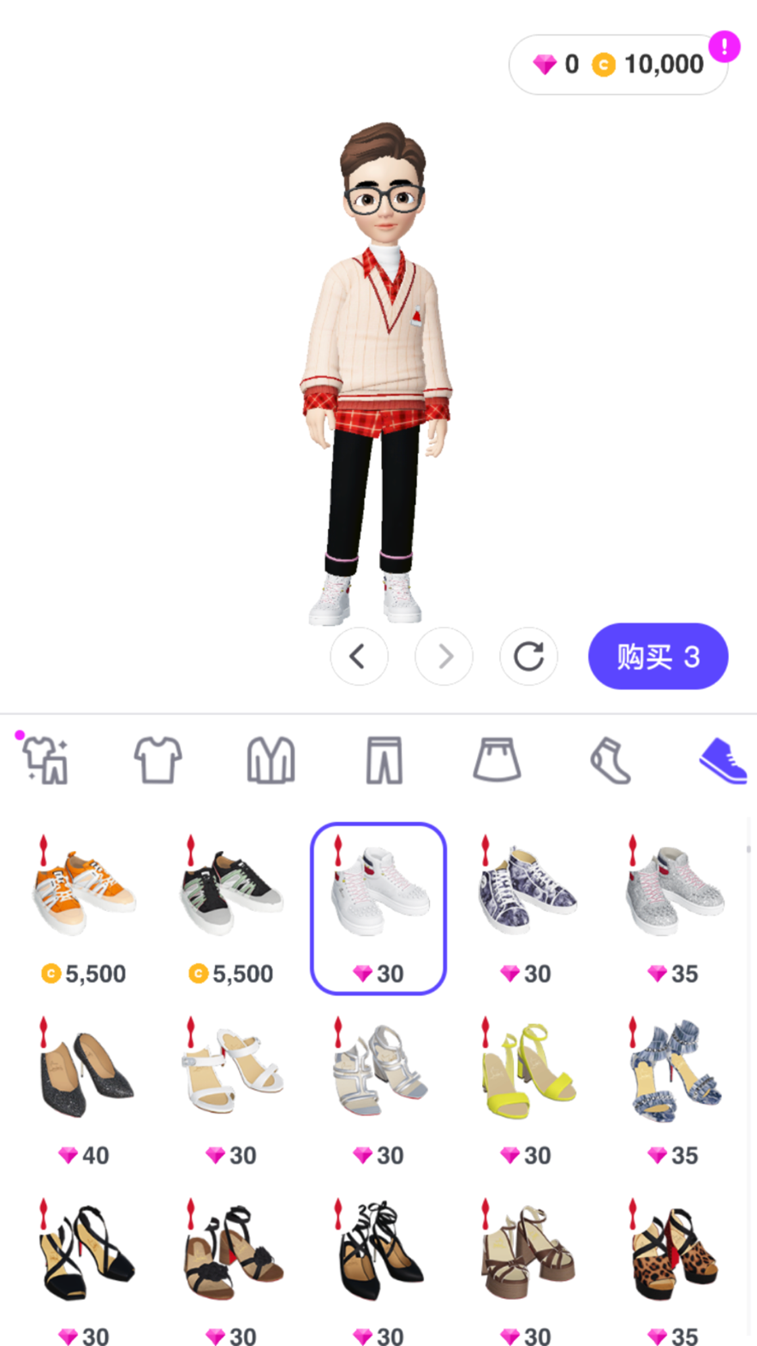
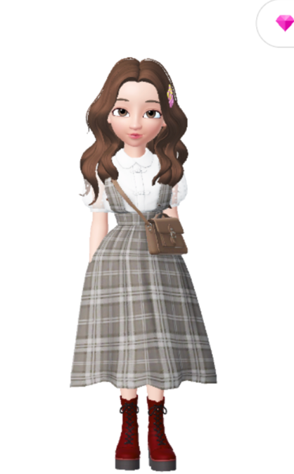
VB Lab Use Instruction
Design: Ziqiao & Ray

Slide 2
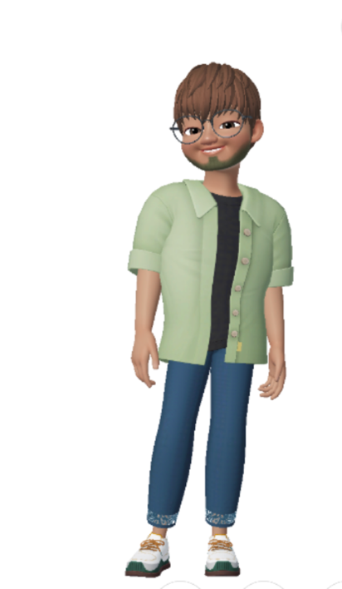
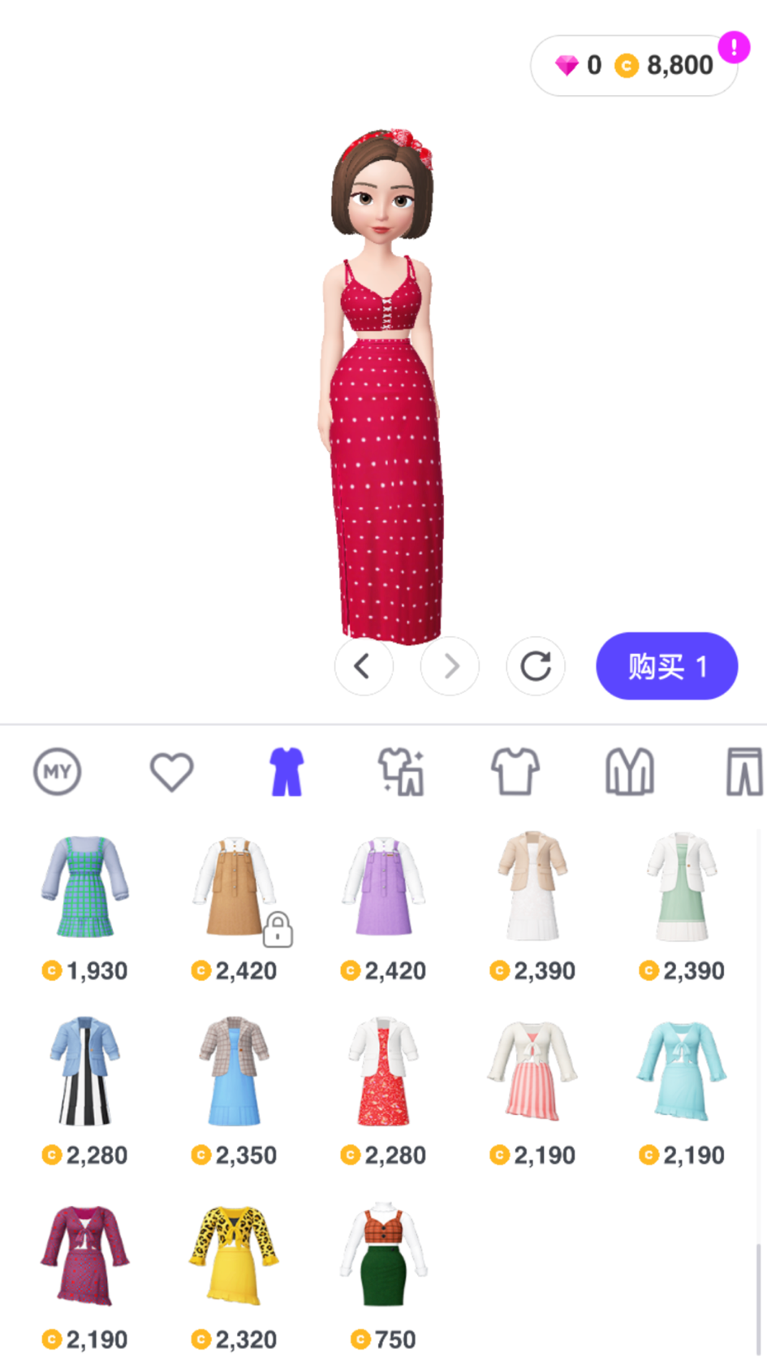
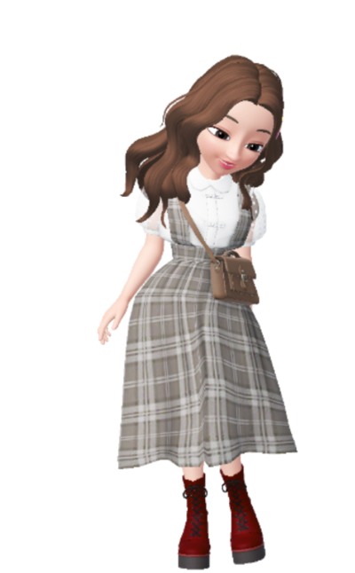
Role Introduction
IRB Committee Member
Sunshine
Participant (research subject)
Ziqiao
Researcher (principal investigator)
Ray
VB Lab Manager
Bin

Slide 3

Part One
Researcher-centered Instruction

Slide 4
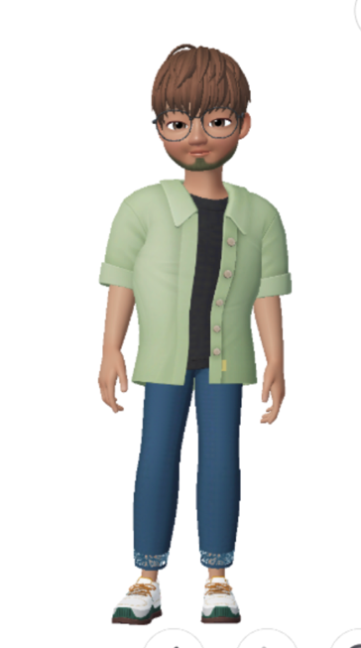
Hi! I’ve heard so much about VB Lab! I am interested in using your lab in my proposed research.
Sure! Thanks for your interest. You need firstly register into VB Lab to attain your subject ID and confirmed email for further application. You can refer to <VB Lab Instruction for Subjects> to see the registration procedure.
I have successfully registered! What’s the next step
I need to do to make the research application?
Firstly, check all the documents and consents of VB Lab to ensure that your experiments strictly comply with the written rules. Secondly, prepare your research proposal and a presentation then email me. I will arrange a meeting with you for your project approval discussion.
Sure! I‘ll prepare right away.

Slide 5
The meeting is organized where researcher and lab manager reached mutual agreement.
Congrats Ray! Your research proposal is well approved by VB Lab, I have already informed you by email of the project approval. Now you need to submit an ethical approval from the IRB committee to me. Please contact irb@dukekunshan.edu.cn for the latest application form.
Dear IRB committee, can I request the latest ethical approval form for research application in VB Lab?
Hi Ray, here is your requested ethical form, please fill in and send back to us for approval so that you can complete your application.
Ray completed the ethical form and successfully got approval form DKU IRB committee.

Slide 6
Hi Bin, I have sent the ethical approval from IRB committee to your email, am I ready to start my research?
Well received! Your research application is well approved!
When conducting experiments, you need to well organize the experiment scheduling pool, arrange experimental options, including schedule making, time slots confirmation and room reservation. If you need to recruit participants, you need to the confirm me with subject recruitment method and process, and then invite and advertise to recruit your subjects. You could refer to <VB Lab Management of Experiment Environment> to see the management rules. Email me for confirmation if any application needed.
Great! I see. Thanks for your instruction.
Another remind is that when launching your experiment, remember to pay great attention to internet stabling, room safety and clean to ensure the normal operation of the experiment and the reuse of the experimental environment.
I absolutely will!

Slide 7
The research is well launched and achieved great success.
Hi Bin, I have already done my research. Thank you and VB Lab so much for support! What else am I supposed to do after my experiment?
You’re welcome! Before you quit the lab, make sure you have completed all the payment process and well dealt with your experiment data. Refer to <VB Lab Policy on Ethics and Compliance> if there’s ant confusion.
Sure! Thank you so much!
🎉🎉🎉🎉

Slide 8
Part Two
Participant-centered Instruction

Slide 9
Hi VB Lab manager! My friend tells me this is a great place where I can learn some economics and win gifts! I am wondering how should I do to be a participant of the lab?
Good question! Welcome to join us! First, we suggest you carefully read <VB Lab Instruction for Subjects> and <Subject Pool Manual> in which you can see notes before registration and usage rules.
Finished! What should I do next?
Then you can register for your own account. Make sure you are above 18 years old. And, if you don’t have a student ID, you can always reach out to us by dku-vblab@dukekunshan.edu.cn to get your subject ID! If you have any concerns or questions about ethics or privacy, please refer to <VB Lab Policy on Privacy Protection> and <VB Lab Ethics and Compliance> these two files!
That is really helpful! Thank you!

Slide 10
Hi dear manager, I just received an experiment invitation from Professor. Ray and I am very interested in that experiment. what am I supposed to do now ?
Good to hear that! So, first, you need to fill a document <Consent to Participate in Research> to indicate to commitment to that experiment. Then both you and Prof. Ray should sign up at the bottom of that document. After signing your name, you are subject to those terms included.
Ok I will sign up! Plus, Ziqiao, if you have any questions about the experiment, feel free to ask!
Participants ask questions and researchers answer them, and then they sign up on the <Consent to Participate in Research>
Okay great! Prof. Ray will send emails about further information about the experiments, such as time, location, training, and payment. Remember, all official communications in the VB Lab are through emails! I wish you both had a great research experience!
🎉🎉🎉🎉

